Slide 1
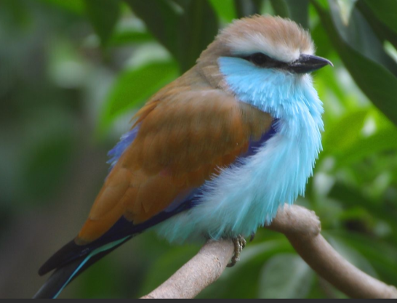
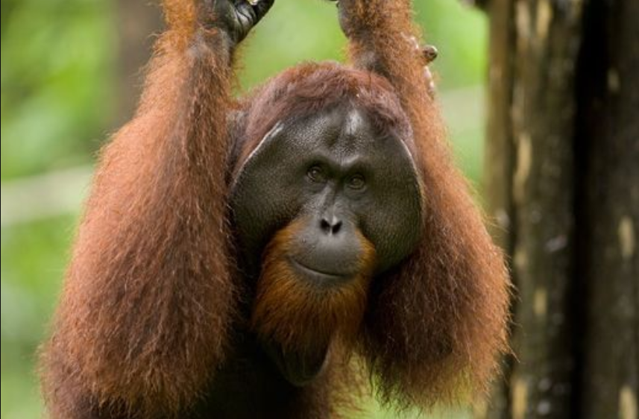
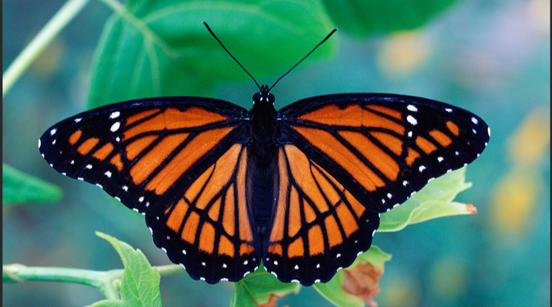
Team Animal
Team leaders: Ravi Sharma, Shen Jean Lim
Members: Martin Lynn, Madeleine Barrow, Matthew Sumpter, Khandaker Tasnim Huq, Youngchul Kim, Ojas Natarajan

Slide 2
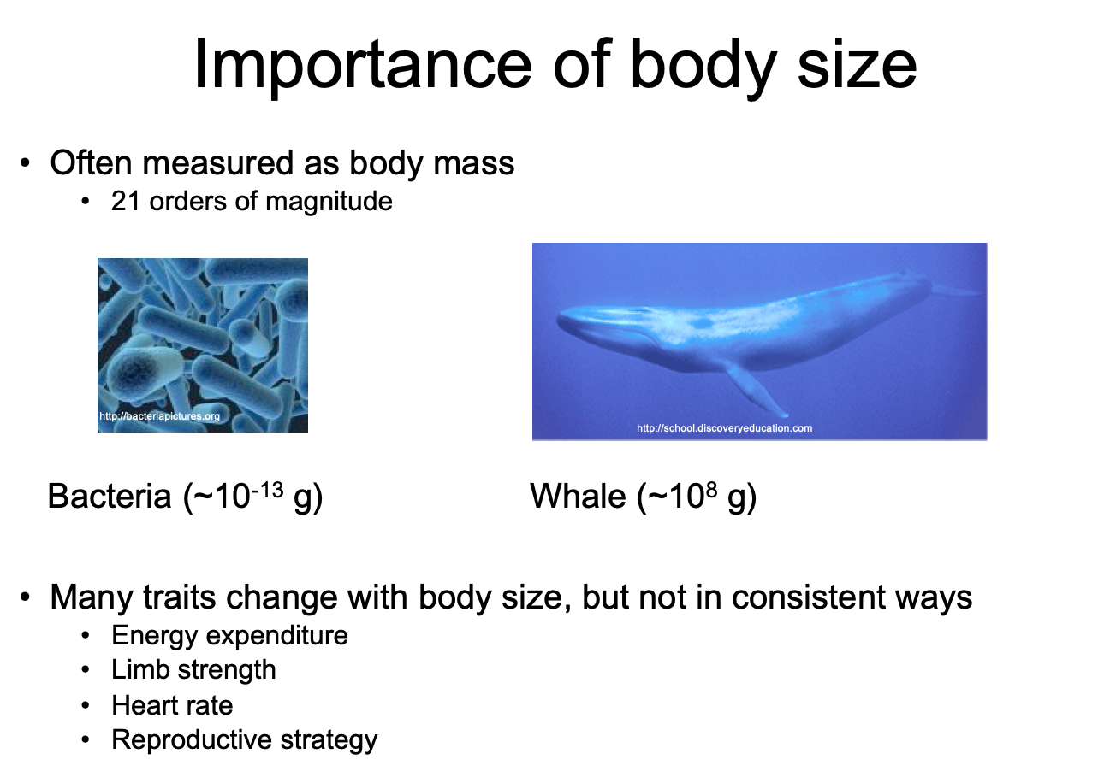

Slide 3
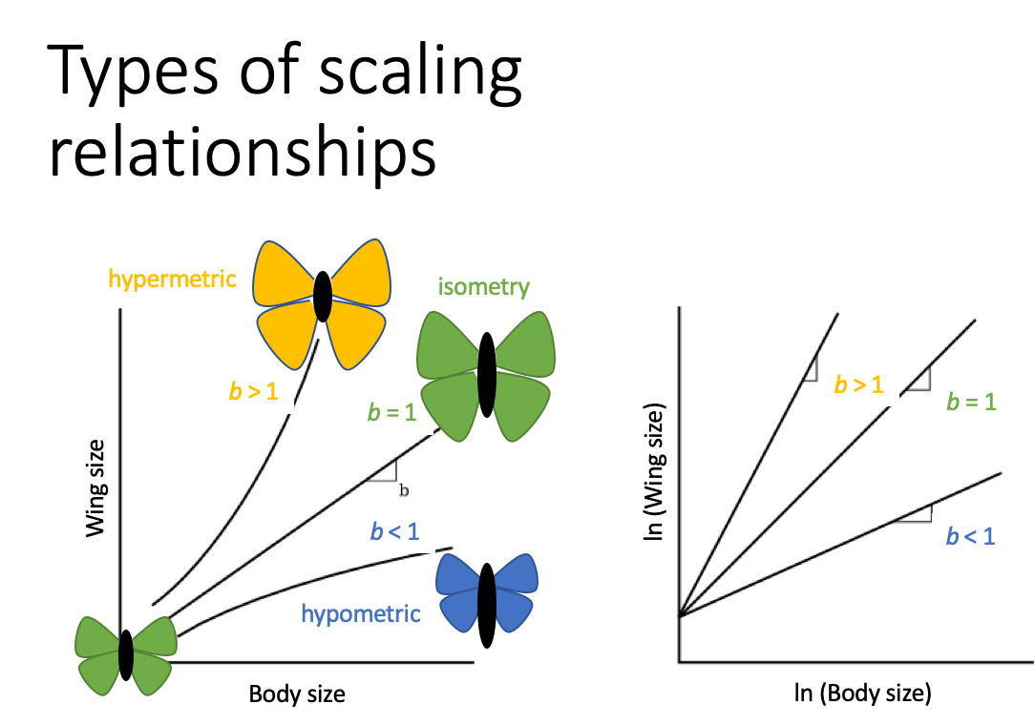

Slide 4
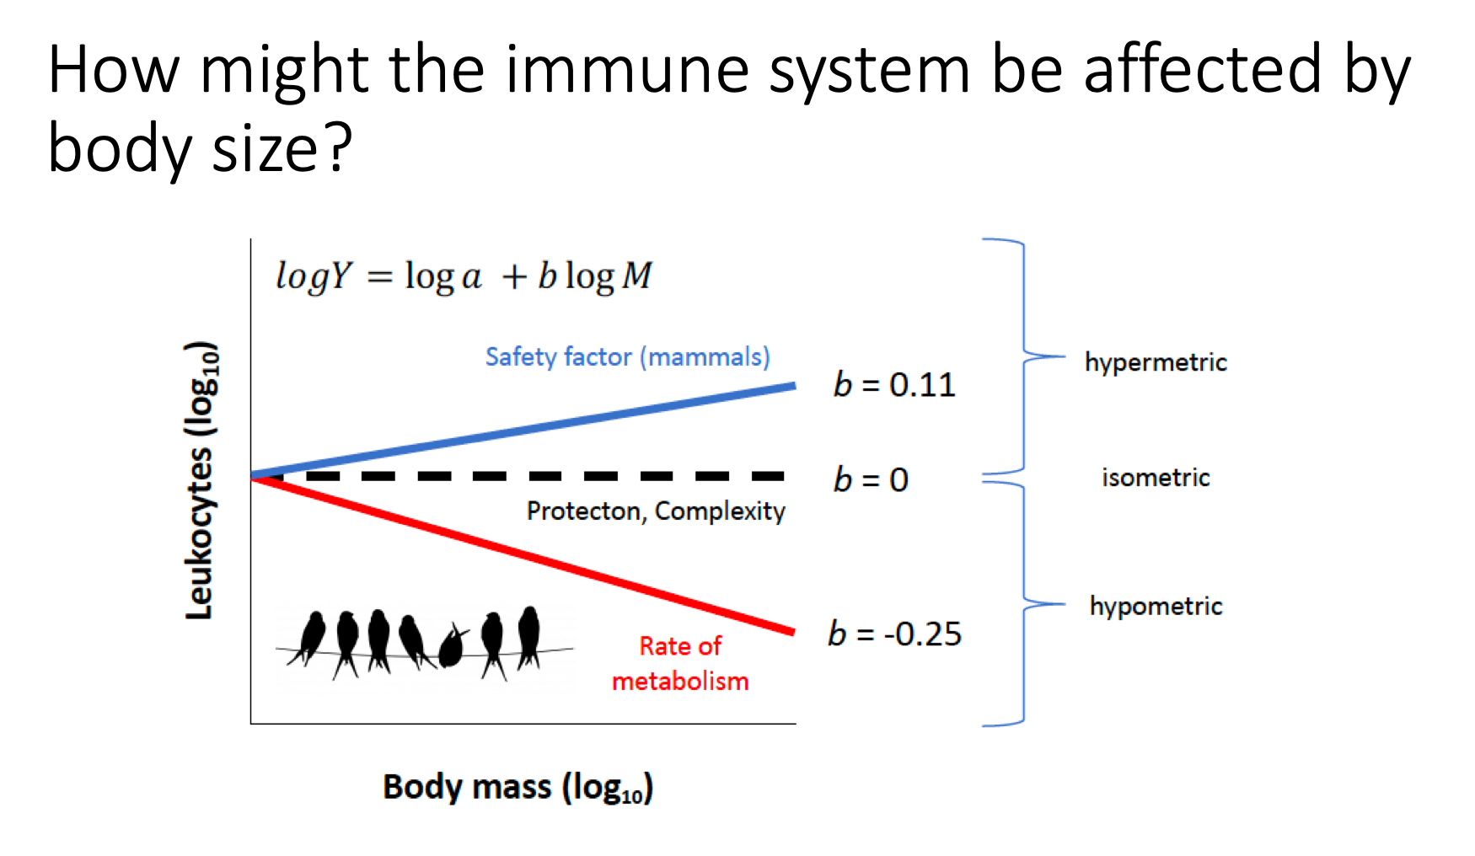

Slide 5
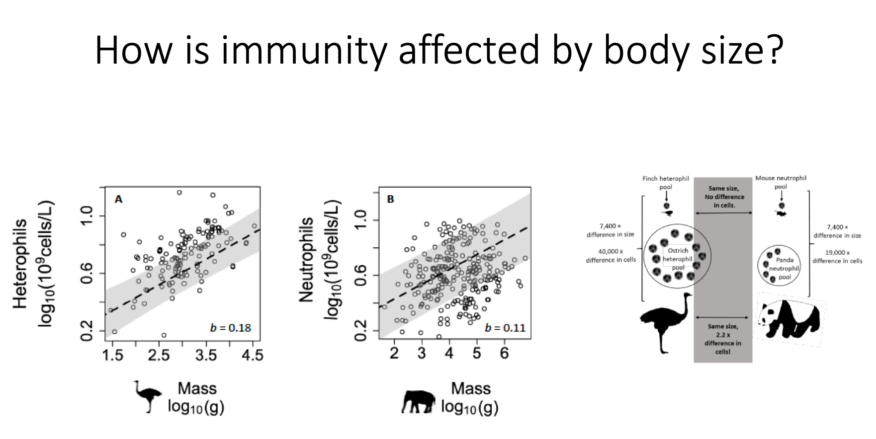

Slide 6
Methods
Download OTUs
Unsupervised clustering
Metadata addition
Pattern recognition
Mining for hypothesis
Microbiome OTUs for animals was obtained from earthmicrobiome.org.
Animals with less than 10 OTUs were excluded.
To identify clusters of host species with similar microbial composition.
Clusters determined using Jensen-Shannon Distances
PAM (partition around medoids)
Metadata for lifespan, body mass, diet, environmental factors, technical factors (e.g., extraction methods) were downloaded from databases (e.g., Anage, Encyclopedia of Life and peer-reviewed papers).
Inter and intra-cluster pattern recognition was performed through Pearson coefficient, permanova analysis
Identify interesting patterns and formulate further hypothesis

Slide 7
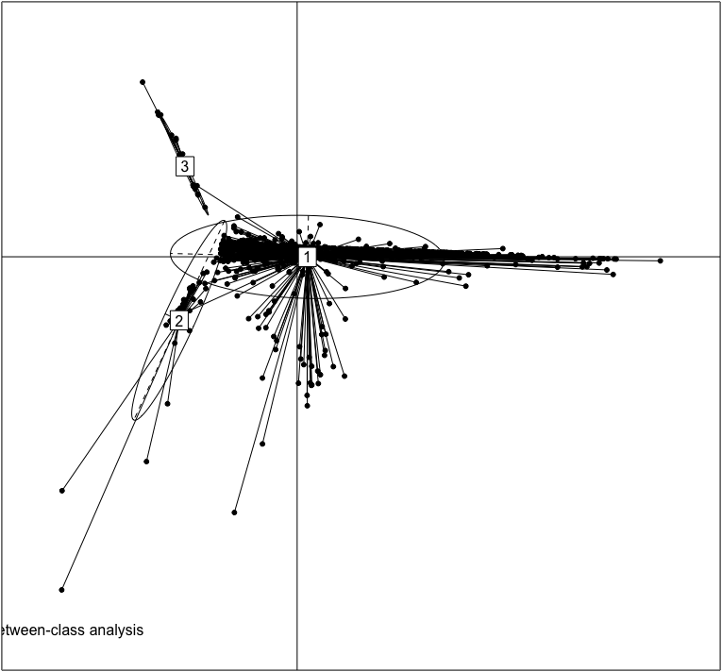
Clusters
Butterflies
( n = 25)
Most species ( n= 667)
Ants, birds, butterflies, other reptiles
(n = 34)

Slide 8
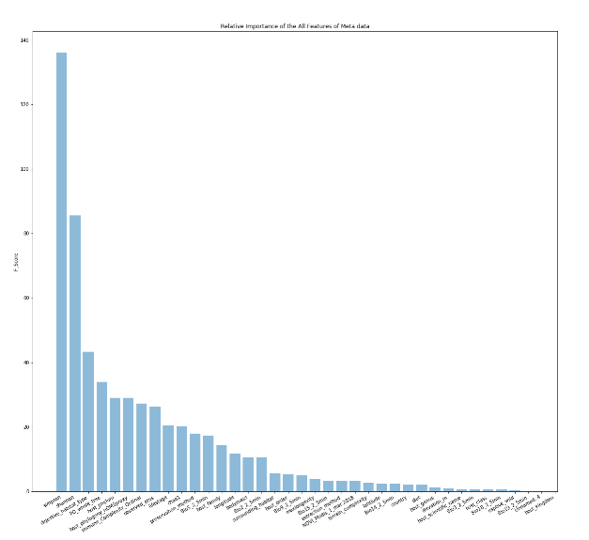
Results
Feature analysis
Lifestage
Body mass
Longevity
Significant

Slide 9
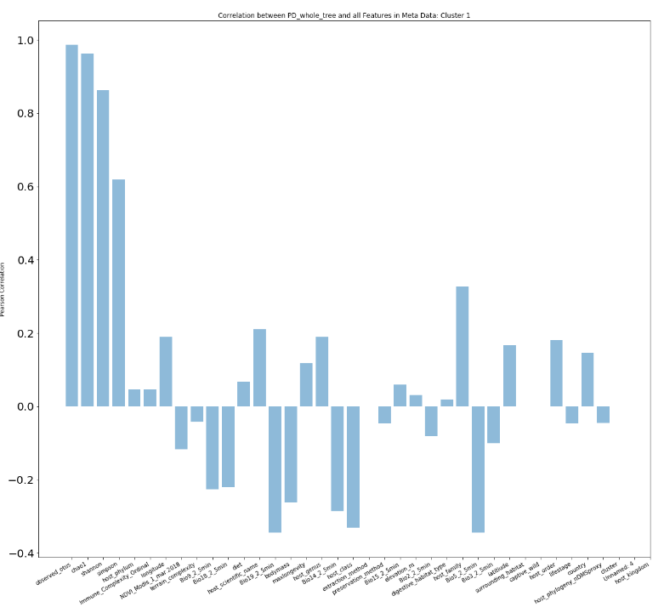
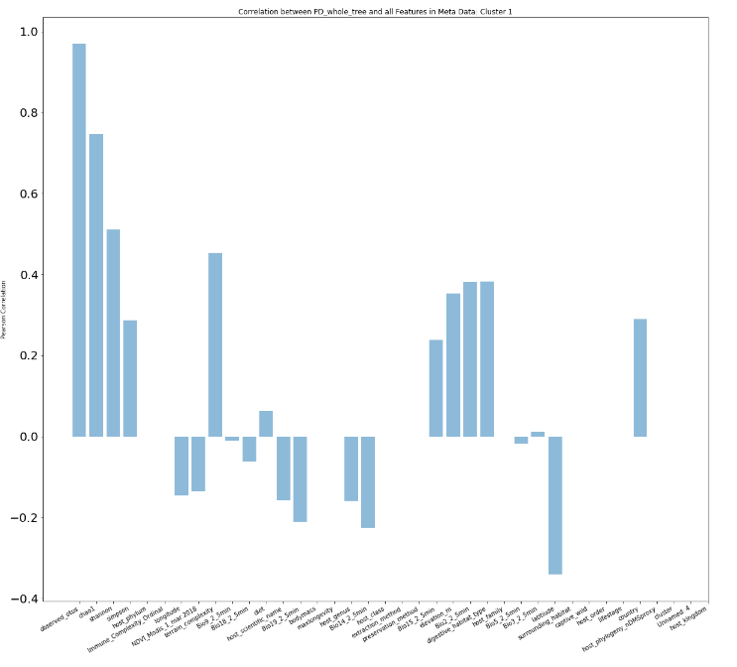
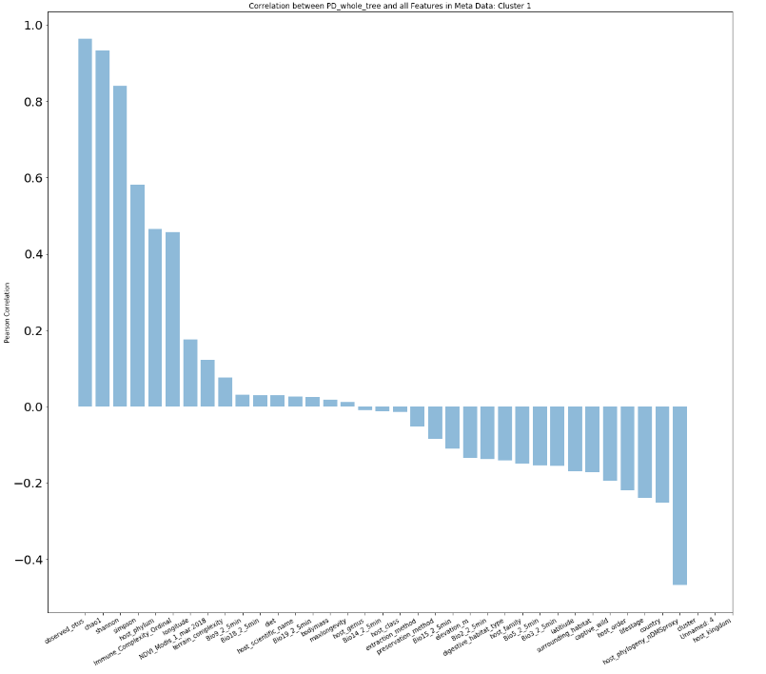

Slide 10
Project
We applied unsupervised learning to animal microbiome data from the Earth Microbiome Project (http://www.earthmicrobiome.org) to determine how microbial communities cluster among host species. We then used other databases to find correlations with various host traits to start to explain the existence of these patterns.​
​What is the problem you want to solve?​
Are there generalities about microbial communities across multicellular forms of life? Do particular host traits (e.g., size, diet, and phylogeny) drive them?​
Why does it matter?​
The scale and dynamic nature of microbial diversity is staggering. Our hope is to reveal general patterns of microbial community organization to serve as a baseline for deeper investigation.​ Our work could also implicate host species where microbial diversity should be exceptionally high, which could provide a source of microbes with novel metabolic effects.

Slide 11
​Why is it challenging?​
The field is fairly new, so sampling of host microbiota diversity is at present fairly sparse. It is currently known that diet, host phylogeny, and few other environmental factors shape host-microbiome assemblies. However, other potential effects on host-associated microbiomes across species, including size and host life history, have been understudied. A comprehensive analysis on drivers of animal microbiomes is challenging but can yield new insights on host-microbiome associations.​
Why are you excited about it?​
A broader perspective such as this one can serve as a solid foundation from which more targeted studies can start. The opportunity to gain insight into host-microbe associations across the scope of animal life is also compelling.​
​What do you need to make it happen?​
Appropriate data and expertise in microbiomes, evolutionary biology, machine learning, statistical analysis and computer programming…and luck and $$ wouldn’t hurt.

